Slide 1

Intermediate topics in Android
Martin Smith
martin@mbs3.org

Slide 2
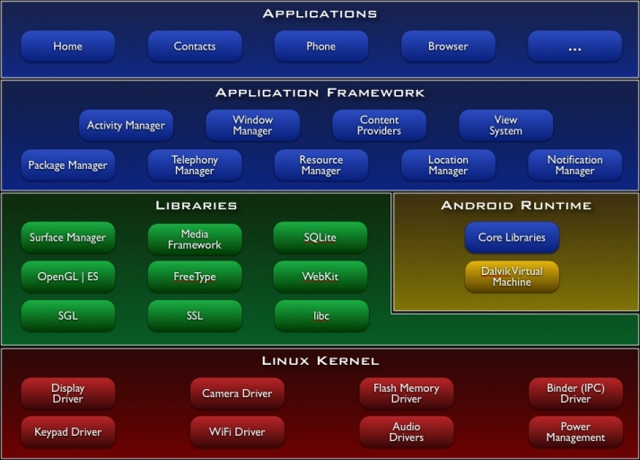
The framework
“Java” APIs
C / JNI (NDK)
Martin Smith
martin@mbs3.org

Slide 3
Topics
Use Ant to build and sign your applications, deploy to AVD
Check out MOTODEV Studio for Android, lots of functionality
(http://developer.motorola.com/docstools/motodevstudio/)
Doing more with WebKit
The Native SDK (NDK)
Alternatives to Eclipse
Common Patterns
Performance tuning
Tools you can use
Solving problems
Other references

Slide 4
Topics
Data storage patterns:
SQLite is preferred over Assets, Raw, XML
Sometimes you must download your data
Use cursors and content providers, or share a service
Don’t forget to cache in memory and on the SD card
Watch for caveats on Assets and XML resources
Alternatives to Eclipse
Common Patterns
Performance tuning
Tools you can use
Solving problems
Other references

Slide 5
Topics
Activities, Services, CPs
TabView, one activity per tab
ContentProvider lazy init
Application class, not really
Service lifecycle
Threading is important, don’t avoid it (AsyncTask)
Don’t overuse Activity grouping, they are slower!
Alternatives to Eclipse
Common Patterns
Performance tuning
Tools you can use
Solving problems
Other references

Slide 6
Topics
Compatibility with devices
Declare screens, configurations, features, libraries, permissions, sdk
Users won’t even see things they can’t run
1.6+ has been totally adequate for my needs
API level should be compatible with higher
Do testing!
Alternatives to Eclipse
Common Patterns
Performance tuning
Tools you can use
Solving problems
Other references

Slide 7
Topics
Functionality!
Maps, GPS
OpenGL
Bluetooth
Media
SMS
Various Sensors
Camera
Google APIs for Android
Existing applications, libs
Alternatives to Eclipse
Common Patterns
Performance tuning
Tools you can use
Solving problems
Other references

Slide 8
Topics
Pay attention to startup!
Avoid creating objects
Prefer final, int over enum
Prefer static, field access
Polymorphism without JIT
Enhanced for loop syntax
double = float, prefer int
Avoid the ANR (200ms)
Alternatives to Eclipse
Common Patterns
Performance tuning
Tools you can use
Solving problems
Other references

Slide 9
Topics
http://developer.android.com/guide/developing/tools
android.os.Debug
Dalvik Debug Monitor (DDMS)
Instrumentation
Traceview, the Monkey, etc
AVD console (:5554)
Web services, SQLite tools, etc
Alternatives to Eclipse
Common Patterns
Performance tuning
Tools you can use
Solving problems
Other references

Slide 10
Topics
Revisit the fundamentals:
Intents can be used to communicate with existing applications, drive Activity change
Content providers can offer integrated full-phone search and suggestions
Activities with views and viewgroups can help you multithread, viewflipper too
Services provide inter-process communication functionality
WebKit can change everything
Alternatives to Eclipse
Common Patterns
Performance tuning
Tools you can use
Solving problems
Other references

Slide 11
Topics
developer.android.com/guide
StackOverflow.com
AndDev.org, AndroidForums.com
Google Group android-developers
Phonegap.com
OpenIntents.org
github.com:
commonsguy/cw-android
kaeppler/droid-fu
Alternatives to Eclipse
Common Patterns
Performance tuning
Tools you can use
Solving problems
Other references

Slide 12

The End

